Slide 1

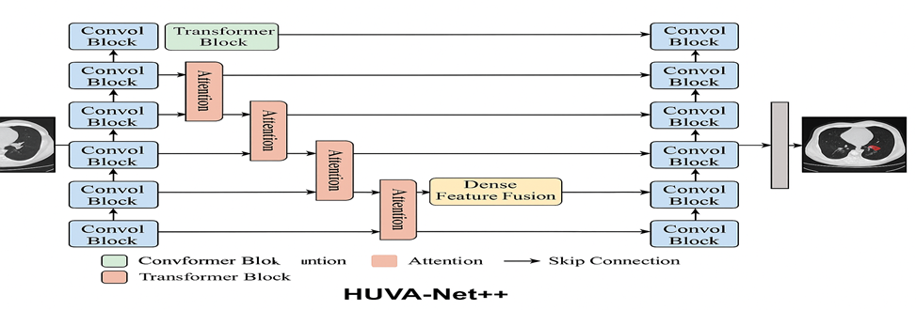
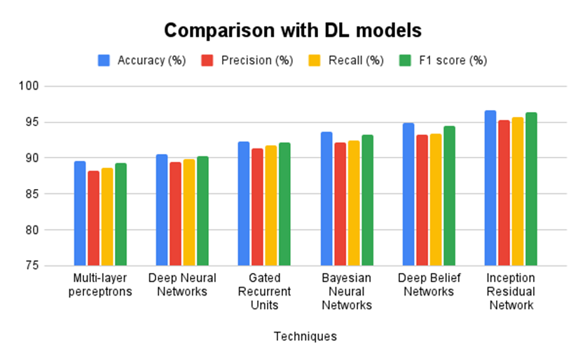

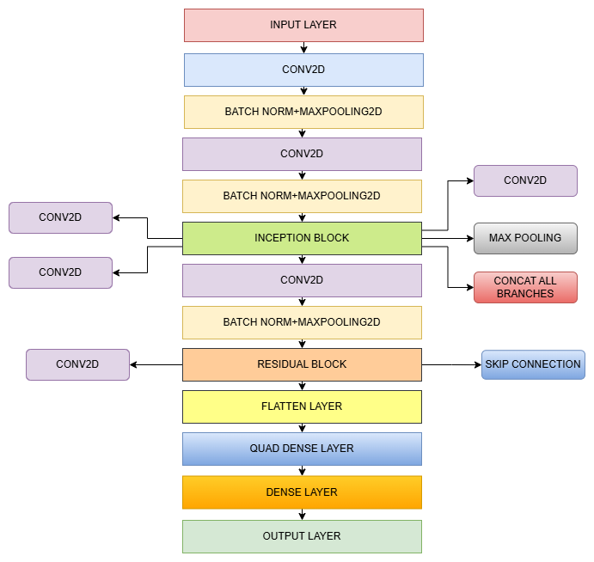
DEEP LEARNING BASED SEGMENTATION AND CLASSIFICATION OF LUNG TUMOR
AMITHA K
(21BAD006)
GOKULANANDAN S
(21BAD023)
KARISHMA R
(21BAD030)
MALINI A
(21BCS066)
SHAKEEL S
(21BIS207)
ABSTRACT
BACKGROUND OF THE STUDY
RESULTS
DISCUSSION
Research Objective: The study aims to develop an efficient lung cancer detection system to facilitate early diagnosis, improve patient outcomes, and reduce the burden of advanced-stage treatments.
Methodology: The system integrates image processing techniques and machine learning models to analyze radiographic images for the identification and classification of lung lesions.
Key Findings: The proposed system demonstrates high accuracy in identifying early-stage lung cancer, offering valuable support to radiologists in decision-making.
Implications: Early detection enhances treatment success rates and lowers healthcare costs. The system's effectiveness can improve cancer survival rates significantly.
Future plans: Future work will focus on enhancing detection precision, scaling the model for larger datasets, and incorporating advanced AI techniques for real-time analysis.
Context: Lung cancer diagnosis is challenging due to subtle tumor variations and limited radiologist expertise. This project leverages deep learning to automate tumor classification, enhancing accuracy and early detection in diverse settings.
Significance: This project is vital for enhancing lung cancer diagnosis by automating early detection and reducing reliance on radiologists. It ensures accurate, efficient, and accessible healthcare solutions for diverse settings.
Identify Gap: This project leverages deep learning to improve automated lung tumor classification, addressing gaps in accuracy and efficiency, especially in resource-limited settings with high workloads. It enhances diagnostic reliability beyond traditional methods.
Key Findings: Achieved 96.7% accuracy using Inception-Residual Network. HUVA-Net++ enabled precise lung tumour segmentation. Outperformed existing ML and DL models.
Visualization: Implemented using Streamlit for interactive CT image upload and analysis. Charts highlight model performance; diagrams show architecture.
Validation: Deep learning outperformed traditional methods. Hybrid models boosted accuracy and segmentation. Early detection supports better clinical decisions.
Interpretation: Findings show deep learning enhances early lung cancer detection and efficiency, broadening healthcare access and encouraging further AI research.
Limitations: The study faces challenges with data requirements, clinical integration, model transparency, and ethical concerns.
OUTCOME
Innovation: A hybrid model combines HUVA-Net++ for tumor segmentation and Inception-ResNet for classification, improving diagnostic accuracy.
Implications: This could enable earlier detection and better treatment outcomes for lung cancer patients.
Social Impact: Improved diagnostic tools may enhance awareness and access to lung cancer screening, boosting survival rates.
Figure 1: HUVA-Net++ Architecture
Figure 2: Comparison of DL Models
SPOTLIGHT OF THE PROJECT
PROCESS/METHODOLOGY
Research Design: Proposes a hybrid model combining HUVA-Net++ for segmentation and Inception-ResNet for classification to enhance diagnostic accuracy.
Data Collection: Gathers CT lung images from diverse datasets, covering various tumor types and stages to build a reliable training set.
Data Pre-Processing: Normalizes and resizes images, focusing on region-of-interest segmentation to improve AI model input quality.
Data Augmentation: Applies rotations, flips, zooms, and shifts to expand data diversity and prevent model overfitting.
Segmentation: Employs HUVA-Net++ integrating U-Net++, attention gates, and vision transformers for precise tumor boundary detection.
Classification: Utilizes a custom Inception-ResNet architecture for robust multi-scale feature extraction, classifying tumors as benign, malignant, or normal.
Segmentation Models | Dice Coefficient (%) | IoU (%) | Sensitivity (%) | Specificity (%)
U-Net | 88.2 | 80.3 | 86.7 | 89.6
3D U-Net | 89.1 | 81.4 | 87.3 | 90.1
V-Net | 90.5 | 83.2 | 88.9 | 91.2
Mask R-CNN | 91.3 | 84.7 | 90.1 | 92.3
HUVA-Net++ | 94.7 | 89.6 | 93.5 | 94.1
QR LINK OF PROJECT VIDEO
Impact and Significance:
This project advances lung cancer diagnosis by enabling early, automated detection using deep learning. It reduces reliance on radiologists, enhances accuracy, and supports faster, personalized treatment.
The integration of Inception-Residual Network and HUVA-Net++ ensures precise segmentation and classification, making cancer care more efficient, accessible, and scalable.
Alignment with Goals:
Broader Objectives: Supports national health initiatives for improved cancer detection.
Specific Goals: Enhances diagnostic accuracy and increases access to lung cancer screening.
Table 1: Comparison with Existing Segmentation models
THARSANEE R M
ASSISTANT PROFESSOR II
DEPARTMENT OF AI&DS

